Slide 1

GSAC / EPOS 2014
31 Mar 2104, UBI, Covilhã, Portugal
Overview of GSAC, part 1
Stuart Wier
UNAVCO
Notes:
1

Slide 2
GSAC is UNAVCO's Geodesy Seamless Archive package.
GSAC is web services.
GSAC provides
complete, modern, and consistent web services,
at geoscience data repositories,
for discovery, sharing, and access to data.

Slide 3
GSAC Collaborators
European GSAC operators, 2013 – 2014:
INGV, Grottominarda, Italy. RING network.
SEGAL, Universidade da Beira Interior, Covilhã, Portugal. SEGAL network
National Observatory of Athens, Greece. NOANet
Geoazur, Université de Nice - Sophia-Antipolis, France. RENAG & RPG
Royal Observatory of Belgium, for the European Permanent Network
Central Bureau. EPN network
The Icelandic Meteorological Office (IMO) / Veðurstofa Íslands, Rejkyavik
National Technical University of Athens, Dionysos Satellite Observatory
Istituto Nazionale di Oceanografia e di Geofisica Sperimentale - OGS, Udine

Slide 4

GSAC Resources Online
For complete information about GSAC, Google UNAVCO GSAC.
The UNAVCO GSAC web site has an introduction to GSAC,
“UNAVCO GSAC: Web Services for Geodesy Data Repositories”,
and much more.

Slide 5
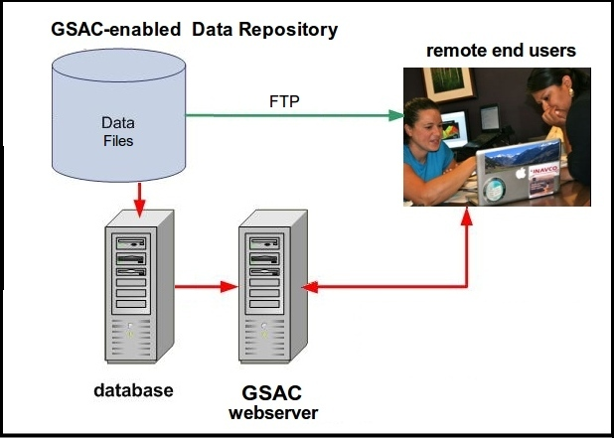
What does GSAC do?
GSAC web services connect a data repository to end data users, over the Internet.
Users query GSAC for information (metadata) about sites (stations), instruments, and instrument data files.
Users receive information about sites (stations) and instruments,
and download instrument data files.

Slide 6
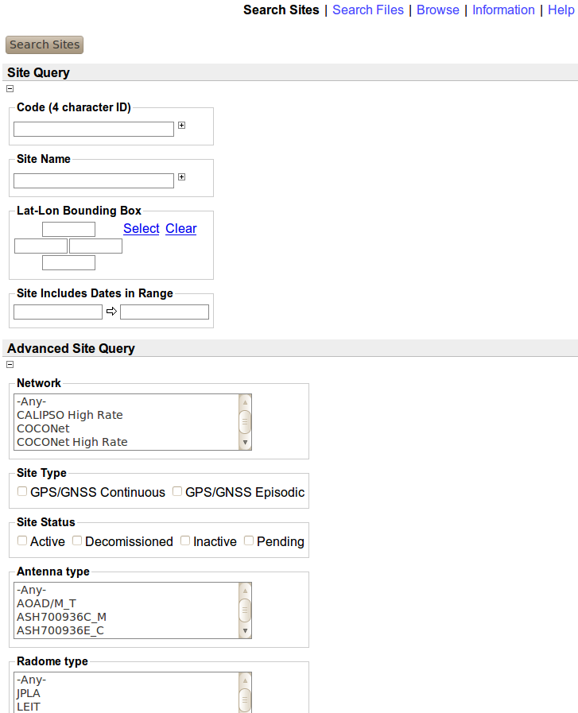
What does GSAC do?
Makes queries (requests)

Slide 7
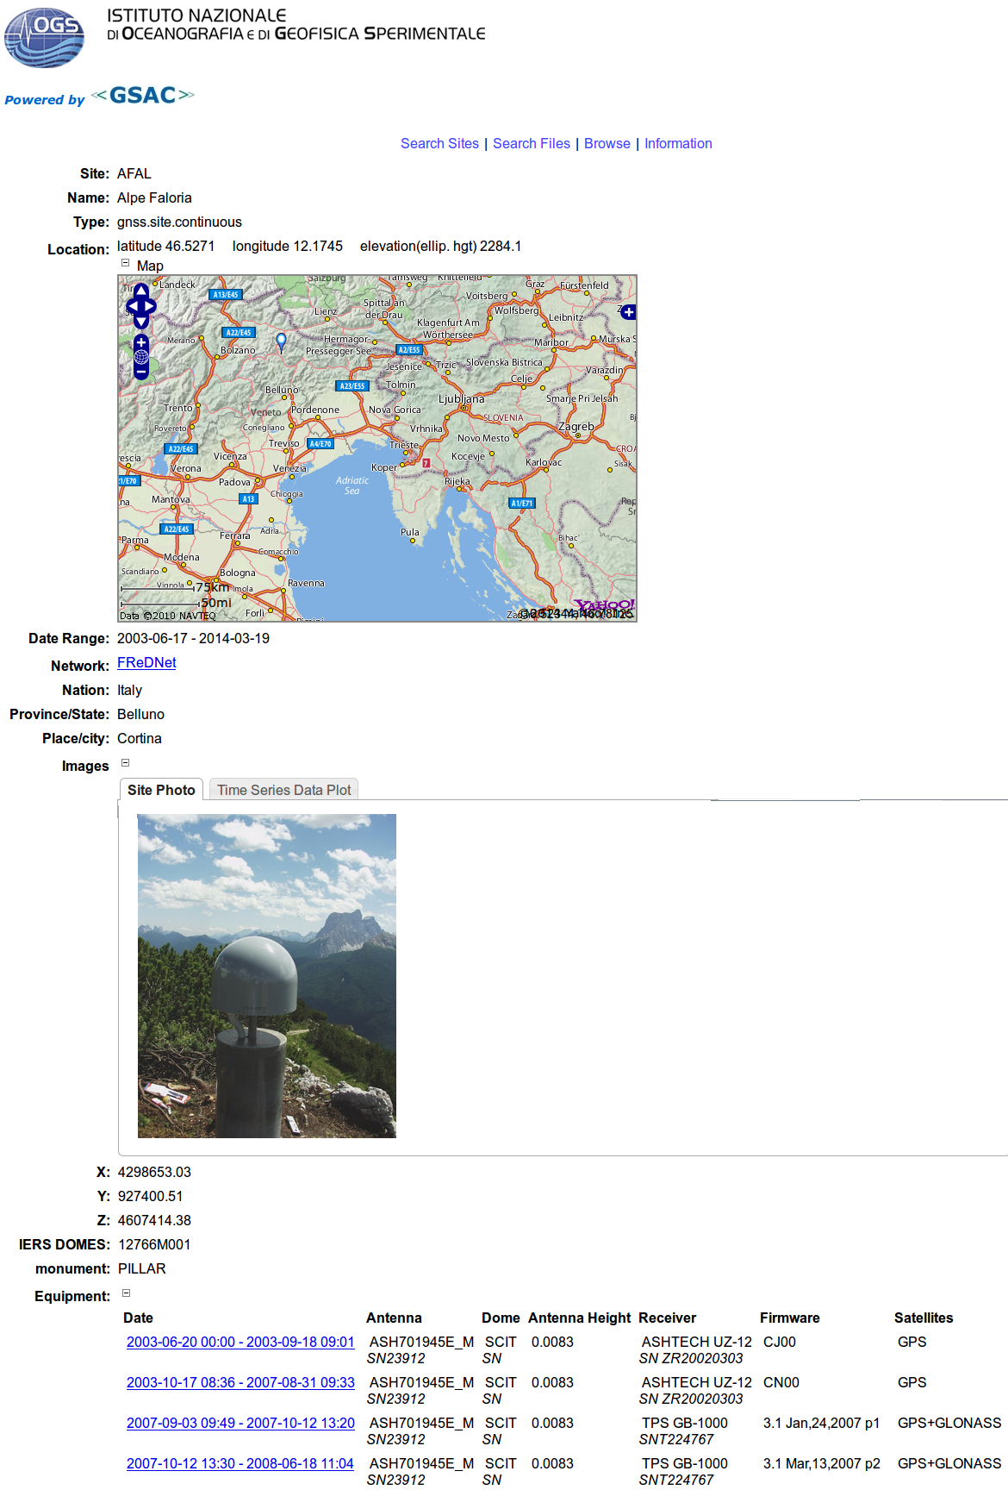
What does GSAC do?
Results: station information (web page)

Slide 8
What does GSAC do?
Results: station information (SINEX)
%=SNX 2.01 COCONet GSAC Repository 14:076:47520
*-------------------------------------------------------------------------------
+SITE/ID
*CODE PT __DOMES__ T _STATION DESCRIPTION__ APPROX_LON_ APPROX_LAT_ _APP_H_
MCAY A P MCAY -75 58 13.4 17 24 55.8 -17.86
PEDR A P PEDR -77 47 3.5 17 1 15.6 -10.34
-SITE/ID
*-------------------------------------------------------------------------------
+SITE/RECEIVER
*SITE PT SOLN T DATA_START__ DATA_END____ DESCRIPTION_________ S/N__ FIRMWARE___
MCAY A 1 P 07:053:69390 07:061:47880 TRIMBLE 4000SSI 26980 7.19
MCAY A 1 P 10:132:58470 10:140:41730 TRIMBLE 4000SSI 26980 7.19
MCAY A 1 P 12:128:52160 12:128:58392 TRIMBLE NETR9 5145K 4.43
PEDR A 1 P 05:144:53445 05:151:82665 TRIMBLE 4000SSI 26980 7.19
PEDR A 1 P 07:149:47790 07:156:48210 TRIMBLE 4000SSI 26980 7.19
PEDR A 1 P 09:251:43260 09:258:77040 TRIMBLE 4000SSI 26980 7.19
PEDR A 1 P 12:080:44961 12:080:50269 TRIMBLE NETR9 5145K 4.43
-SITE/RECEIVER
*-------------------------------------------------------------------------------
+SITE/ANTENNA
*SITE PT SOLN T DATA_START__ DATA_END____ DESCRIPTION_________ S/N__
MCAY A 1 P 07:053:69390 07:061:47880 TRM29659.00 17520
MCAY A 1 P 10:132:58470 10:140:41730 TRM41249.00 -----
MCAY A 1 P 12:128:52160 12:128:58392 TRM39105.00 11909
PEDR A 1 P 05:144:53445 05:151:82665 TRM29659.00 17520
PEDR A 1 P 07:149:47790 07:156:48210 TRM29659.00 17520
PEDR A 1 P 09:251:43260 09:258:77040 TRM29659.00 17520
PEDR A 1 P 12:080:44961 12:080:50269 TRM39105.00 11909
-SITE/ANTENNA
*-------------------------------------------------------------------------------
+SITE/ECCENTRICITY
* UP______ NORTH___ EAST____
*SITE PT SOLN T DATA_START__ DATA_END____ AXE ARP->BENCHMARK(M)_________
MCAY A 1 P 07:053:69390 07:061:47880 UNE 0.5500 0.0000 0.0000
MCAY A 1 P 10:132:58470 10:140:41730 UNE 0.5500 0.0000 0.0000

Slide 9
GSAC Components
The GSAC package of services is built with the concept of
stations (sites or monuments),
at fixed locations (latitude and longitude),
with instruments,
making instrument data files.
A data center with GSAC has
data and product files for public download, on an FTP server,
a database with metadata about the stations, instruments, and files,
a GSAC server, which receives requests, reads from the database, and sends results to remote end users.

Slide 10
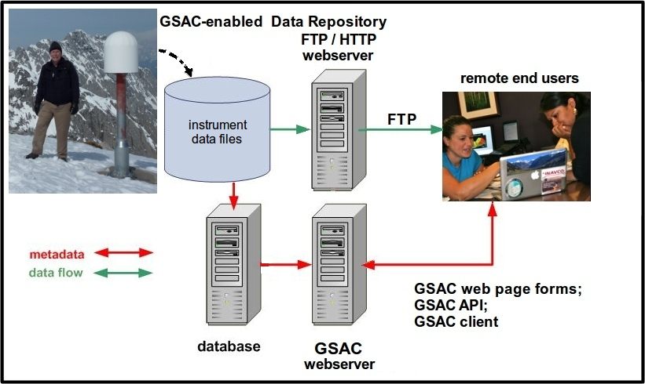
GSAC data center basic architecture

Slide 11
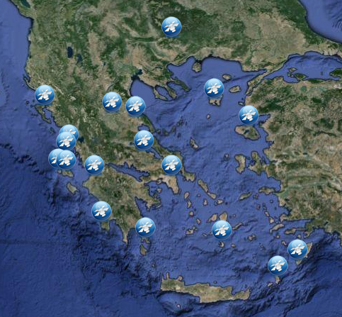
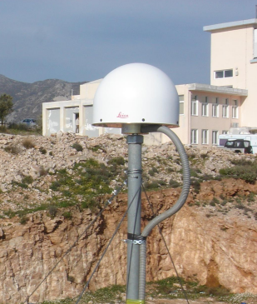
GSAC Candidate Data Center
Sites with instruments that produce geoscience data (such as GNSS observations)
Data files (raw to products)
Data files’ metadata
Site metadata
Instrument metadata
Systems:
Database server
Web application server
File server (FTP)

Slide 12
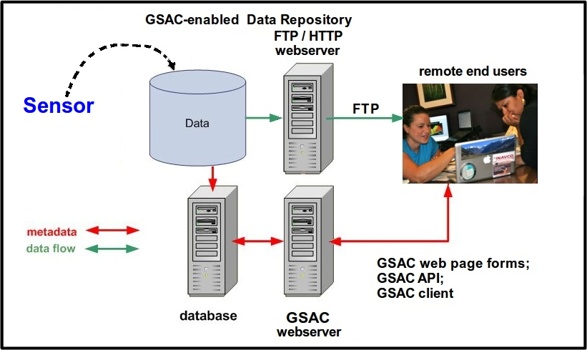
GSAC: many sensors and many data types
GSAC is not coded for particular instruments or data types. You can offer raw sensor data files, processed data files, products, and images.
GSAC servers in operation handle GNSS, VLBI, SLR, DORIS, and tide gauge instruments and data files. No code changes are needed to GSAC to use new instruments or data file types. For example, you could use tiltmeters, strainmeters, weather sensors, time series product files and images, magnetotelluric data, or seismic infrasound sensors.

Slide 13
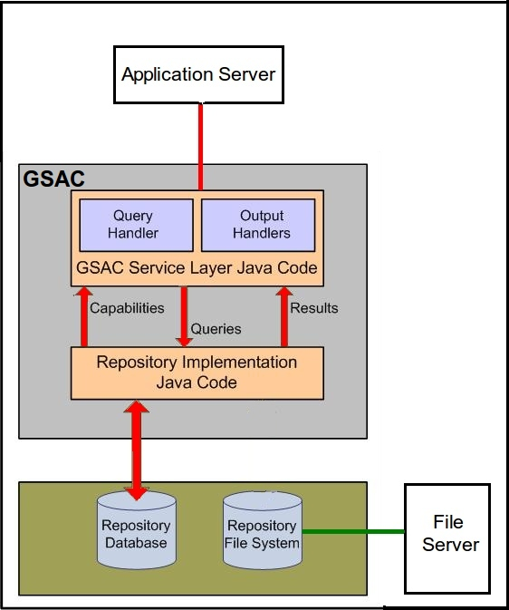
GSAC basic code architecture (1)
A GSAC Repository has
a database with geodesy metadata (sites and data)
instrumental data files
a file server (FTP or HTTP)
custom Java code
a few configuration files
GSAC core code (“GSAC service layer” Java code)
a web application server (Tomcat, Jetty)

Slide 14
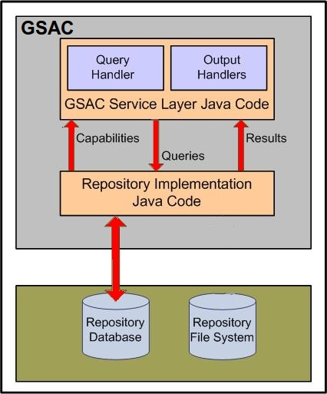
GSAC basic code architecture (2)
The Data Center retains its structure.
GSAC does not “know about” or use the local data file system.
GSAC does not use the local FTP file server.
GSAC uses only a local database to know about the data center.

Slide 15
GSAC basic code architecture (3)
The local (custom) implementation Java code:
defines the parameters and code for queries,
defines code and parameter values to return results to the end user,
and vocabulary equivalence.
There is a standard set of Java for local implementation code, to simplify GSAC installation. See details in the UNAVCO GSAC web site, Installation page.

Slide 16
GSAC basic code architecture (4)
The GSAC core code (“GSAC Service Layer”) is common for all GSAC repositories.
The core code provides:
all code for web services
all output formatting (HTMP pages, SINEX, GAMIT, csv files, GoogleEarth KMZ, JSON, plain text, etc.)
a standard SQL interface: methods for MySQL, Oracle, and Postgres.
the GSAC API for handling programmatic requests and output handling

Slide 17
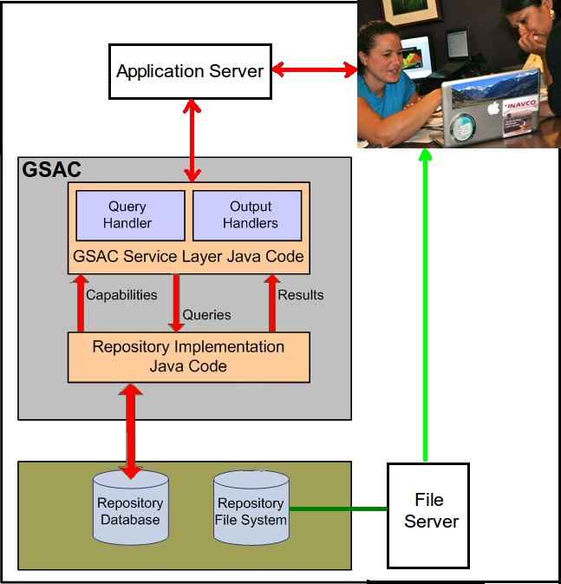
GSAC basic code architecture

Slide 18
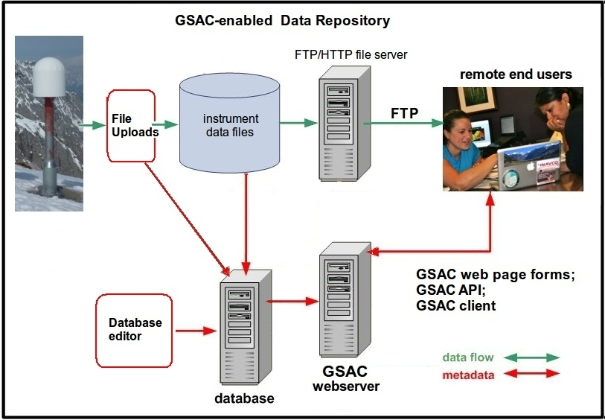
Data repository with GSAC:
the complete data center architecture

Slide 19
GSAC
Time for questions.
.

Slide 20
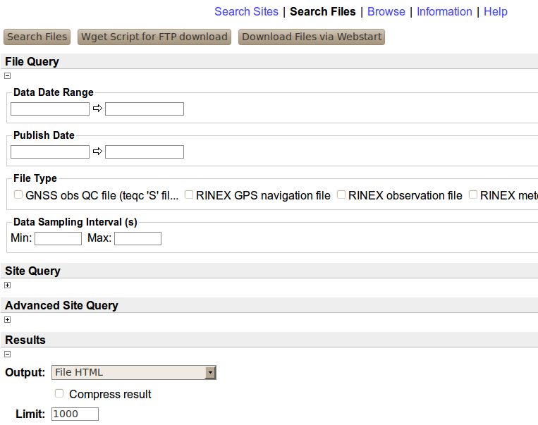
GSAC Use: Web forms

Slide 21
GSAC Use: Web Site Search Choices
Site Search choices:
code (ID)
station name
latitude - longitude
station installed dates
network name
antenna type
radome type
receiver type
station style (as 'continuous')
station status (as 'active')
country
province / region / state
place name / city
and
all site search result types

Slide 22
GSAC Use: Web File Search Choices
File Search choices:
Date or date range
'published' date range
file type (as RINEX obs file)
data sampling interval (as 15 s)
and
all site choices
and
all file search result types

Slide 23
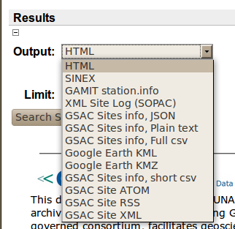
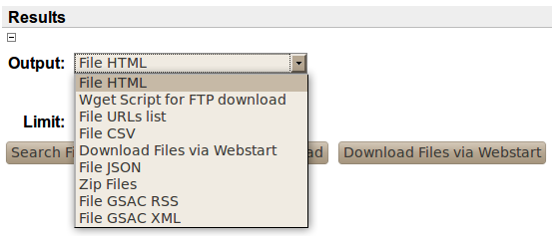
GSAC Use: Output Formats
Site Search Output Choices:
File Search Output choices:

Slide 24
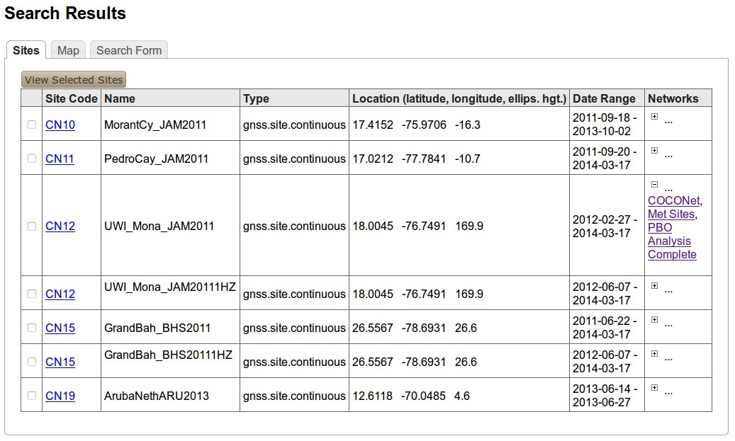
GSAC site result formats:
HTML Sites Table

Slide 25
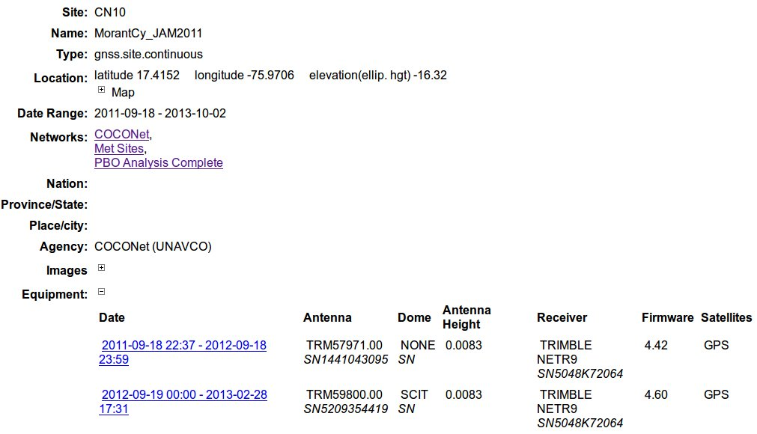
GSAC site result formats:
HTML single Site page

Slide 26
GSAC site result formats:
SINEX
%=SNX 2.01 COCONet GSAC Repository 14:076:47520
*-------------------------------------------------------------------------------
+SITE/ID
*CODE PT __DOMES__ T _STATION DESCRIPTION__ APPROX_LON_ APPROX_LAT_ _APP_H_
MCAY A P MCAY -75 58 13.4 17 24 55.8 -17.86
PEDR A P PEDR -77 47 3.5 17 1 15.6 -10.34
-SITE/ID
*-------------------------------------------------------------------------------
+SITE/RECEIVER
*SITE PT SOLN T DATA_START__ DATA_END____ DESCRIPTION_________ S/N__ FIRMWARE___
MCAY A 1 P 07:053:69390 07:061:47880 TRIMBLE 4000SSI 26980 7.19
MCAY A 1 P 10:132:58470 10:140:41730 TRIMBLE 4000SSI 26980 7.19
MCAY A 1 P 12:128:52160 12:128:58392 TRIMBLE NETR9 5145K 4.43
PEDR A 1 P 05:144:53445 05:151:82665 TRIMBLE 4000SSI 26980 7.19
PEDR A 1 P 07:149:47790 07:156:48210 TRIMBLE 4000SSI 26980 7.19
PEDR A 1 P 09:251:43260 09:258:77040 TRIMBLE 4000SSI 26980 7.19
PEDR A 1 P 12:080:44961 12:080:50269 TRIMBLE NETR9 5145K 4.43
-SITE/RECEIVER
*-------------------------------------------------------------------------------
+SITE/ANTENNA
*SITE PT SOLN T DATA_START__ DATA_END____ DESCRIPTION_________ S/N__
MCAY A 1 P 07:053:69390 07:061:47880 TRM29659.00 17520
MCAY A 1 P 10:132:58470 10:140:41730 TRM41249.00 -----
MCAY A 1 P 12:128:52160 12:128:58392 TRM39105.00 11909
PEDR A 1 P 05:144:53445 05:151:82665 TRM29659.00 17520
PEDR A 1 P 07:149:47790 07:156:48210 TRM29659.00 17520
PEDR A 1 P 09:251:43260 09:258:77040 TRM29659.00 17520
PEDR A 1 P 12:080:44961 12:080:50269 TRM39105.00 11909
-SITE/ANTENNA
*-------------------------------------------------------------------------------
+SITE/ECCENTRICITY
* UP______ NORTH___ EAST____
*SITE PT SOLN T DATA_START__ DATA_END____ AXE ARP->BENCHMARK(M)_________
MCAY A 1 P 07:053:69390 07:061:47880 UNE 0.5500 0.0000 0.0000
MCAY A 1 P 10:132:58470 10:140:41730 UNE 0.5500 0.0000 0.0000

Slide 27
GSAC site result formats:
GAMIT station.info
* Gamit station.info
*
* Generated by the COCONet GSAC Repository at 2014-03-17T13:16:58 -0600
*
*SITE Station Name Session Start Session Stop Ant Ht HtCod Ant N Ant E Receiver Type Vers SwVer Receiver SN Antenna Type Dome Antenna SN
MCAY MCAY 2007 53 19 16 30 2007 61 13 18 00 0.55 ----- 0.0000 0.0000 TRIMBLE 4000SSI 7.19 7.19 26980 TRM29659.00 ----- 175206
MCAY MCAY 2010 132 16 14 30 2010 140 11 35 30 0.55 ----- 0.0000 0.0000 TRIMBLE 4000SSI 7.19 7.19 26980 TRM41249.00 ----- --------------------
MCAY MCAY 2012 128 14 29 20 2012 128 16 13 12 0.018 ----- 0.0000 0.0000 TRIMBLE NETR9 4.43 4.43 5145K79600 TRM39105.00 ----- 11909599
PEDR PEDR 2005 144 14 50 45 2005 151 22 57 45 0.55 ----- 0.0000 0.0000 TRIMBLE 4000SSI 7.19 7.19 26980 TRM29659.00 ----- 175206
PEDR PEDR 2007 149 13 16 30 2007 156 13 23 30 0.55 ----- 0.0000 0.0000 TRIMBLE 4000SSI 7.19 7.19 26980 TRM29659.00 ----- 175206
PEDR PEDR 2009 251 12 01 00 2009 258 21 24 00 0.55 ----- 0.0000 0.0000 TRIMBLE 4000SSI 7.19 7.19 26980 TRM29659.00 ----- 175206

Slide 28
GSAC site result formats:
SOPAC XML Site Log
<igsSiteLog xsi:schemaLocation="http://sopac.ucsd.edu/ns/geodesy/doc/igsSiteLog/2011 http://sopac.ucsd.edu/ns/geodesy/doc/igsSiteLog/2011/igsSiteLog.xsd"><formInformation><mi:preparedBy>COCONet GSAC Repository</mi:preparedBy><mi:datePrepared>2014-03-17T13:23:09</mi:datePrepared><mi:reportType>DYNAMIC</mi:reportType></formInformation><siteIdentification><mi:siteName>MCAY</mi:siteName><mi:fourCharacterID>MCAY</mi:fourCharacterID><mi:dateInstalled>2007-02-22T00:00:00</mi:dateInstalled>
<mi:monumentInscription/><mi:iersDOMESNumber/><mi:cdpNumber/><mi:monumentDescription/><mi:heightOfTheMonument/><mi:monumentFoundation/><mi:foundationDepth/><mi:markerDescription/><mi:geologicCharacteristic/><mi:bedrockType/><mi:bedrockCondition/><mi:fractureSpacing/><mi:faultZonesNearby/><mi:distance-Activity/><mi:notes/></siteIdentification>
<siteLocation><mi:country/><mi:state/><mi:city/><mi:approximatePositionITRF><mi:latitude-North>17.4155</mi:latitude-North><mi:longitude-East>-75.9704</mi:longitude-East><mi:elevation-m_ellips>0</mi:elevation-m_ellips></mi:approximatePositionITRF></siteLocation>
<gnssReceiver><equip:receiverType>TRIMBLE 4000SSI </equip:receiverType><equip:serialNumber>26980</equip:serialNumber><equip:firmwareVersion>7.19 </equip:firmwareVersion><equip:dateInstalled>2007-02-22T19:16:30</equip:dateInstalled><equip:dateRemoved>2007-03-02T13:18:00</equip:dateRemoved><equip:satelliteSystem>GPS</equip:satelliteSystem><equip:elevationCutoffSetting/><equip:temperatureStabilization/><equip:notes/></gnssReceiver>
<gnssAntenna><equip:antennaType>TRM29659.00 </equip:antennaType><equip:serialNumber>175206</equip:serialNumber><equip:marker-arpUpEcc.>0.55</equip:marker-arpUpEcc.><equip:marker-arpNorthEcc.>0</equip:marker-arpNorthEcc.><equip:marker-arpEastEcc.>0</equip:marker-arpEastEcc.><equip:alignmentFromTrueNorth/><equip:antennaRadomeType> </equip:antennaRadomeType><equip:radomeSerialNumber> </equip:radomeSerialNumber><equip:antennaCableType/><equip:antennaCableLength/><equip:dateInstalled>2007-02-22T19:16:30</equip:dateInstalled><equip:dateRemoved>2007-03 02T13:18:00</equip:dateRemoved>
...

Slide 29
GSAC site result formats:
GSAC JSON site information
[{"Id":"MCAY","Type":{"Id":"gnss.site.episodic","Label":
"gnss.site.episodic"},"ShortName":"MCAY","LongName":"MCAY","Metadata":[
{"Label":"politicallocation","ForDisplay":true},{"Type":"property",
"Label":"Agency","ForDisplay":true},{"Label":"Images","ForDisplay":
true}],"MetadataLevel":0,"ResourceGroups":[{"Id":
"COCONet Jamaica Cays 2012","Label":"COCONet Jamaica Cays 2012"}],
"RelatedResources":[],"EarthLocation":{"Latitude":17.4155,"Longitude":
-75.9704,"Elevation":-17.86,"X":NaN,"Y":NaN,"Z":NaN},"FromDate":
"Feb 22, 2007","ToDate":"May 7, 2012","SampleInterval":0.0},{"Id":
"PEDR","Type":{"Id":"gnss.site.episodic","Label":"gnss.site.episodic"},
"ShortName":"PEDR","LongName":"PEDR","Metadata":[{"Label":
"politicallocation","ForDisplay":true},{"Type":"property","Label":
"Agency","ForDisplay":true},{"Label":"Images","ForDisplay":true}],
"MetadataLevel":0,"ResourceGroups":[{"Id":"COCONet Jamaica Cays 2012",
"Label":"COCONet Jamaica Cays 2012"}],"RelatedResources":[],
"EarthLocation":{"Latitude":17.021,"Longitude":-77.7843,"Elevation":
-10.34,"X":NaN,"Y":NaN,"Z":NaN},"FromDate":"May 24, 2005","ToDate":
"Mar 20, 2012","SampleInterval":0.0}

Slide 30
GSAC site result formats:
GSAC Plain Text
GSAC data respository: site information in plain text for visual inspection.
Generated by the COCONet GSAC Repository on 2014-03-17 13:30:45
Empty times (no characters) may mean 'not removed' or 'no change.'
This format may change without notice. Not intended for computer processing.
site 1 (in this list):
site four char ID: MCAY
site place name: MCAY
site continuous or campaign: gnss.site.episodic
site agency: COCONet (UNAVCO)
site IERSDOMES:
site installed date: 2007-02-22 00:00:00
site removed date: 2012-05-07 00:00:00
site monument description:
site frequency standard:
site cdp number:
site country:
site state or province:
site city/place:
site latitude: 17.4155
site longitude: -75.9704
site TRF or Datum name:
site ellipsoid height: -17.86
site ellipsoid name:
site X coordinate:
site Y coordinate:
site Z coordinate:
site elevation: (height above geoid model)
geoid model name:
Receiver info; equipment session 1
receiver type: TRIMBLE 4000SSI
receiver SN: 26980
receiver firmware vers: 7.19
receiver firmware SwVer: 7.19
receiver sample intervl:0.0
receiver installed date:2007-02-22 19:16:30
receiver removed date: 2007-03-02 13:18:00
Antenna info; equipment session 1
antenna type: TRM29659.00
antenna SN: 175206
antenna offset Ht (up): 0.55

Slide 31
GSAC site result formats:
GSAC full comma-separated value
#fields=ID[type='string'],station name[type='string'],latitude,longitude,ellip. height[unit='m'],monument description[type='string'],IERSDOMES[type='string'],start time[type='date' format='yyyy-MM-ddTHH:mm:ss zzzzz'],stop time[type='date' format='yyyy-MM-ddTHH:mm:ss zzzzz'],antenna type[type='string'],dome type[type='string'],antenna SN[type='string'],Ant dZ,Ant dN,Ant dE,receiver type[type='string'], firmware version[type='string'], receiver SN[type='string'],sample interval,SwVer,site count
# Generated by COCONet GSAC Repository on 2014-03-17 13:34:33
# Missing times (no characters) may mean 'not removed' or 'no change.'
MCAY,MCAY,17.4155,-75.9704,-17.86,,,2007-02-22 19:16:30,2007-03-02 13:18:00,TRM29659.00 , , 175206,0.55,0.0000,0.0000,TRIMBLE 4000SSI ,7.19 ,26980,0.0, 7.19,1
MCAY,MCAY,17.4155,-75.9704,-17.86,,,2010-05-12 16:14:30,2010-05-20 11:35:30,TRM41249.00 , ,N/A,0.55,0.0000,0.0000,TRIMBLE 4000SSI ,7.19 ,26980,0.0, 7.19,1
MCAY,MCAY,17.4155,-75.9704,-17.86,,,2012-05-07 14:29:20,2012-05-07 16:13:12,TRM39105.00 , ,11909599,0.018,0.0000,0.0000,TRIMBLE NETR9 ,4.43 ,5145K79600,0.0, 4.43,1
PEDR,PEDR,17.021,-77.7843,-10.34,,,2005-05-24 14:50:45,2005-05-31 22:57:45,TRM29659.00 , ,175206,0.55,0.0000,0.0000,TRIMBLE 4000SSI ,7.19 ,26980,0.0, 7.19,2
PEDR,PEDR,17.021,-77.7843,-10.34,,,2007-05-29 13:16:30,2007-06-05 13:23:30,TRM29659.00 , ,175206,0.55,0.0000,0.0000,TRIMBLE 4000SSI ,7.19 ,26980,0.0, 7.19,2
PEDR,PEDR,17.021,-77.7843,-10.34,,,2009-09-08 12:01:00,2009-09-15 21:24:00,TRM29659.00 , ,175206,0.55,0.0000,0.0000,TRIMBLE 4000SSI ,7.19 ,26980,0.0, 7.19,2
PEDR,PEDR,17.021,-77.7843,-10.34,,,2012-03-20 12:29:21,2012-03-20 13:57:49,TRM39105.00 , ,11909599,0.018,0.0000,0.0000,TRIMBLE NETR9 ,4.43 ,5145K79600,0.0, 4.43,2

Slide 32
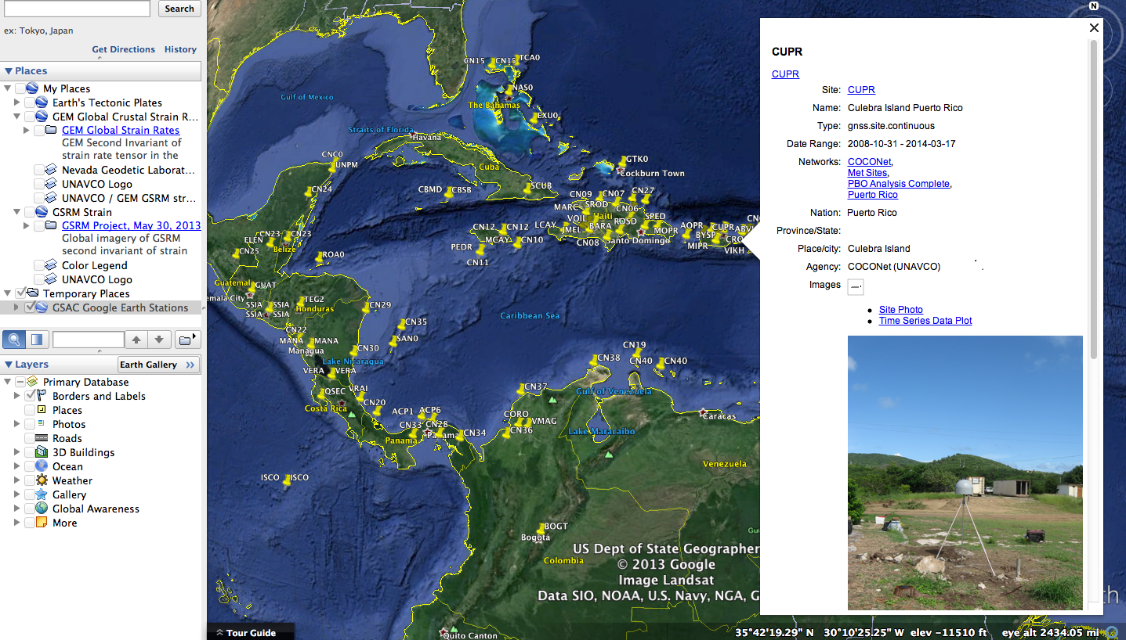
GSAC site result formats:
Google Earth KMZ and KML

Slide 33
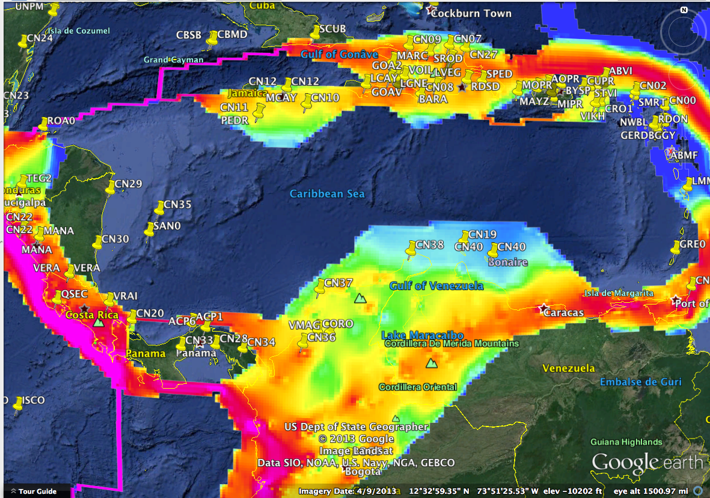
GSAC site results (KMZ) with other data, in Google Earth

Slide 34
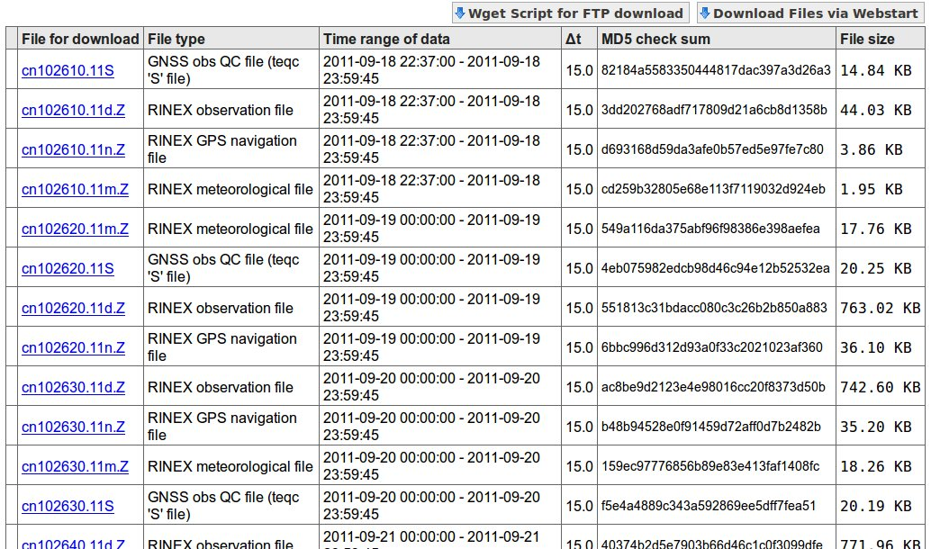
GSAC file search result formats:
File table (HTML)

Slide 35
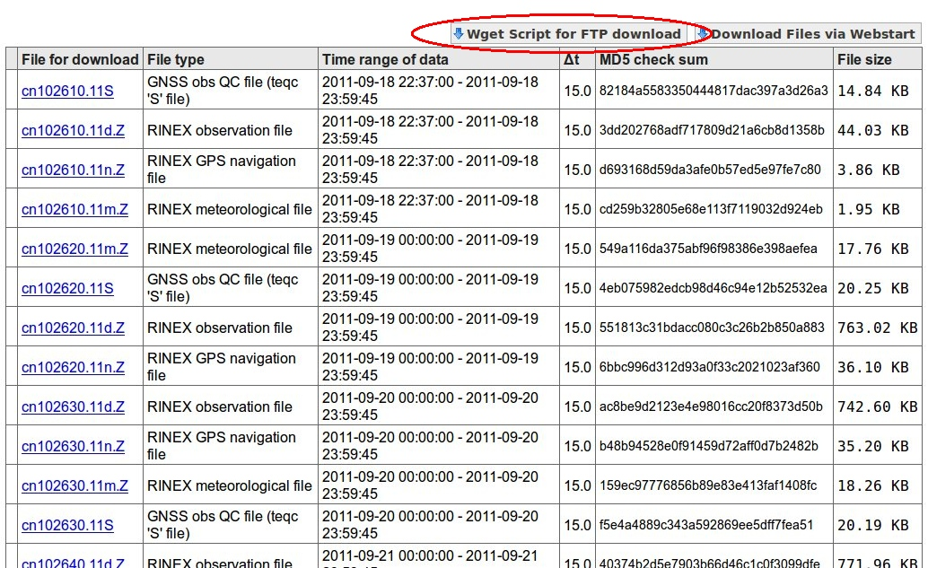
GSAC file search result formats:
File table –> wget script access

Slide 36
GSAC file search result formats:
wget script
wget ftp://www.crs.inogs.it/pub/gps/rinex/2014/053/suse0530.14s.Z
wget ftp://www.crs.inogs.it/pub/gps/rinex/2014/054/suse0540.14n.Z
wget ftp://www.crs.inogs.it/pub/gps/rinex/2014/054/suse0540.14s.Z
wget ftp://www.crs.inogs.it/pub/gps/rinex/2014/054/suse0540.14d.Z
wget ftp://www.crs.inogs.it/pub/gps/rinex/2014/055/suse0550.14d.Z
wget ftp://www.crs.inogs.it/pub/gps/rinex/2014/055/suse0550.14n.Z
wget ftp://www.crs.inogs.it/pub/gps/rinex/2014/055/suse0550.14s.Z
wget ftp://www.crs.inogs.it/pub/gps/rinex/2014/056/suse0560.14d.Z
wget ftp://www.crs.inogs.it/pub/gps/rinex/2014/056/suse0560.14n.Z
wget ftp://www.crs.inogs.it/pub/gps/rinex/2014/056/suse0560.14s.Z
wget ftp://www.crs.inogs.it/pub/gps/rinex/2014/057/suse0570.14s.Z
wget ftp://www.crs.inogs.it/pub/gps/rinex/2014/057/suse0570.14d.Z
wget ftp://www.crs.inogs.it/pub/gps/rinex/2014/057/suse0570.14n.Z
wget ftp://www.crs.inogs.it/pub/gps/rinex/2014/058/suse0580.14d.Z
wget ftp://www.crs.inogs.it/pub/gps/rinex/2014/058/suse0580.14n.Z
wget ftp://www.crs.inogs.it/pub/gps/rinex/2014/058/suse0580.14s.Z
wget ftp://www.crs.inogs.it/pub/gps/rinex/2014/059/suse0590.14s.Z
wget ftp://www.crs.inogs.it/pub/gps/rinex/2014/059/suse0590.14d.Z
wget ftp://www.crs.inogs.it/pub/gps/rinex/2014/059/suse0590.14n.Z
wget ftp://www.crs.inogs.it/pub/gps/rinex/2014/060/suse0600.14d.Z
wget ftp://www.crs.inogs.it/pub/gps/rinex/2014/060/suse0600.14n.Z
...

Slide 37
GSAC file search result formats:
URLs of data files to download
http://egelados.gein.noa.gr/services/GPS/GPS_DATA/2013/001/orid1430.13d.Z
http://egelados.gein.noa.gr/services/GPS/GPS_DATA/2013/001/orid1430.13n.Z
http://egelados.gein.noa.gr/services/GPS/GPS_DATA/2013/002/orid0020.13n.Z
http://egelados.gein.noa.gr/services/GPS/GPS_DATA/2013/002/orid0020.13d.Z
http://egelados.gein.noa.gr/services/GPS/GPS_DATA/2013/003/orid0030.13n.Z
http://egelados.gein.noa.gr/services/GPS/GPS_DATA/2013/003/orid0030.13d.Z
http://egelados.gein.noa.gr/services/GPS/GPS_DATA/2013/004/orid0040.13d.Z
http://egelados.gein.noa.gr/services/GPS/GPS_DATA/2013/004/orid0040.13n.Z
http://egelados.gein.noa.gr/services/GPS/GPS_DATA/2013/005/orid0050.13d.Z
http://egelados.gein.noa.gr/services/GPS/GPS_DATA/2013/005/orid0050.13n.Z
http://egelados.gein.noa.gr/services/GPS/GPS_DATA/2013/006/orid0060.13n.Z
http://egelados.gein.noa.gr/services/GPS/GPS_DATA/2013/006/orid0060.13d.Z
http://egelados.gein.noa.gr/services/GPS/GPS_DATA/2013/007/orid0070.13n.Z
http://egelados.gein.noa.gr/services/GPS/GPS_DATA/2013/007/orid0070.13d.Z
http://egelados.gein.noa.gr/services/GPS/GPS_DATA/2013/008/orid0080.13d.Z
http://egelados.gein.noa.gr/services/GPS/GPS_DATA/2013/008/orid0080.13n.Z
http://egelados.gein.noa.gr/services/GPS/GPS_DATA/2013/009/orid0090.13d.Z
http://egelados.gein.noa.gr/services/GPS/GPS_DATA/2013/009/orid0090.13n.Z

Slide 38
GSAC Use: the API
GSAC has a complete RESTful API (application interface). You compose a URL to do queries and choose a format for the results, without using the GSAC UI web page forms. This allows programmatic (computer) queries.
http://facility.unavco.org/gsacws/gsacapi/site/search?site.code=P210
http://facility.unavco.org/gsacws/gsacapi/site/search?site.code=P210&output=site.snx
http://facility.unavco.org/gsacws/gsacapi/file/search?site.group=COCONet&output=
file.csv&file.datadate.from=2013-11-01&file.datadate.to=2014-01-31& site.interval=interval.normal&limit=100 >
coconet_2013Nov-2014Jan_file_metadata.csv
With the Linux “curl” utility:
> curl “http://facility.unavco.org/gsacws/gsacapi/site/search?site.code=P210“
you can run all GSAC requests from a command line, or in a script, with no browser.
See the User Guide for GSAC Geoscience Data Repositories on the UNAVCO GSAC website for complete details.

Slide 39
GSAC Use: the client program
There is a GSAC client program (gsacclient.jar) for programmatic searches of a GSAC repository and to download files. The GSAC client is available as part of the GSAC package.
This program is an alternative on Windows for the use of 'curl' commands on Linux.
The client may be run on Linux also.
On a command line:
> gsacclient.sh -server http://facility.unavco.org/gsacws
-site.code P120
> gsacclient.sh -server http://facility.unavco.org/gsacws
-site.code P120 -output site.snx
> gsacclient.sh -file site.code p123 -file.datadate.from 2010-09-01 -file.datadate.to 2010-09-15 -output file.url
See the User Guide for GSAC Geoscience Data Repositories on the UNAVCO GSAC website for complete details.

Slide 40

GSAC: How to learn to use GSAC
Read
the book of
Instructions!
http://facility.unavco.org/data/gsacws/docs/UNAVCO_GSAC_User_Guide.pdf

Slide 41
GSAC
Time for questions.
.

Slide 42
GSAC Data Sharing Principles
GSAC uses UNAVCO's open data policy.
This policy is similar to the data sharing principles of the Group on Earth Observations (GEO, http://www.earthobservations.org/):
All shared data, metadata and products being free of charge or no more than cost of reproduction will be encouraged for research and education.
You may choose not to share some data.
You need not share all your data, with everyone, all the time.

Slide 43
GSAC Data Sharing Principles
From “Risk Management”, Nature, lead editorial, vol 498, page 271 (20 June 2013):
“… data should be as comprehensive as possible. Governments and universities world wide should embrace transparency and publish and pool their seismic, planning, and socio-economic data….”
“…a major part of GEM’s (Global Earthquake Model) legacy lies in bringing together previously unpublished local data under one umbrella.”

Slide 44
GSAC Data Sharing:
User Accounts
User Accounts
GSAC does not use, know about, or manage user accounts to control use of GSAC, or to control data access from a data center.
User accounts for GSAC services would render difficult or impossible consistent and uniform use of GSAC data centers, and would largely prevent the operation of federated GSACs.
You may, if you wish, install user account access controls for FTP data file download servers. This is not part of GSAC.
In that case, an end data user can “discover” science data files at your data center with GSAC, but needs an account to download any data files.

Slide 45
GSAC Data Access Controls
GSAC provides ways to hide from all public searches selected instrument data files and/or site metadata in your data center.
hide site metadata, by individual site
hide site metadata, by individual site with “embargo times”
hide data files, all data files from a site
hide data files, by individual file
hide data files, by individual file with “embargo times”

Slide 46
GSAC is Web Services
GSAC has a well-defined purpose, to provide complete and consistent web services for data repositories.
GSAC enables powerful tools for discovery, sharing, and access to data.
GSAC is not a management system for operation of a data repository.
GSAC does not read or write data files. GSAC does not write values to a database. GSAC does not “know” the “meaning” of data. GSAC does not “know” data file formats. GSAC does not read the data files it serves. GSAC does not do data processing. GSAC does no error checking.
This is required by GSAC's fundamental design, being open to serving any kind of file.

Slide 47
GSAC: No Error Correction
In most cases GSAC does not recognize data errors, and does not do error correction, and cannot do error correction.
GSAC does not have domain knowledge, so GSAC can not detect bad data, or guess what is intended by bad data.
GSAC expects that GSAC operators, and end data users, are best qualified to detect and correct errors.
GSAC does attempt to operate normally when 'impossible' data values are encountered, such as undefined data values, or 'zero' dates. Bad or missing data is usually shown to the end user.
GSAC's ability to handle most any station-instrument data means that it does not provide error correction for any particular kind of data.

Slide 48
GSAC Sample Data Errors
Sample errors encountered by GSAC:
Many errors in data handled by GSAC are either undetectable by a computer program, or there is inadequate information to correct them.
Station location provided in database; longitude value is incorrect:
CN36 latitude 8.8197 longitude 75.8211 (in India)
True location:
CN36 latitude 8.8197 longitude -75.8211 (in Columbia)
Instrument data at one station; times are both incorrect or missing:
receiver_installed_date | receiver_removed_date
instrument set one: 2005-09-06 00:00:00 | 2006-01-13 07:59:00
instrument set two: 2006-01-13 05:00:00 | in use
antenna_installed_date | antenna_removed_date
instrument set one: (null) | (null)
instrument set two: 2006-06-08 00:00:00 | in use

Slide 49
GSAC Operational Demands
Installation time demands:
GSAC package (code) installation: <1 day to 2 weeks
Database creation: <1 day to 2 weeks
Total GSAC installation time: approximately 1 to 3 weeks
See installation details in the UNAVCO GSAC web site,
“GSAC Installation” page.

Slide 50

GSAC Operational Demands
Operations:
GSAC package updates and maintenance: infrequent or occasional
Database updates and maintenance: continuous
Data file repository changes and operations: continuous

Slide 51
GSAC
Time for questions.
.

Slide 52

.
Thanks for your attention
Muito obrigado por sua atenção
Molte grazie per la vostra attenzione
ευχαριστώ πολύ για την προσοχή σας
Merci pour votre attention
Margir takk fyrir athyglina
Vielen Dank für Ihre Aufmerksamkeit
Gracias por su atención
www.unavco.org
Notes:
52

